Slide 1


Slide 2


Slide 3


Slide 5


Slide 7


Slide 8


Slide 9


Slide 11
The following slide can be
used in place of the definition of
“talebearer” depending on the verse translation you are using.

Slide 12
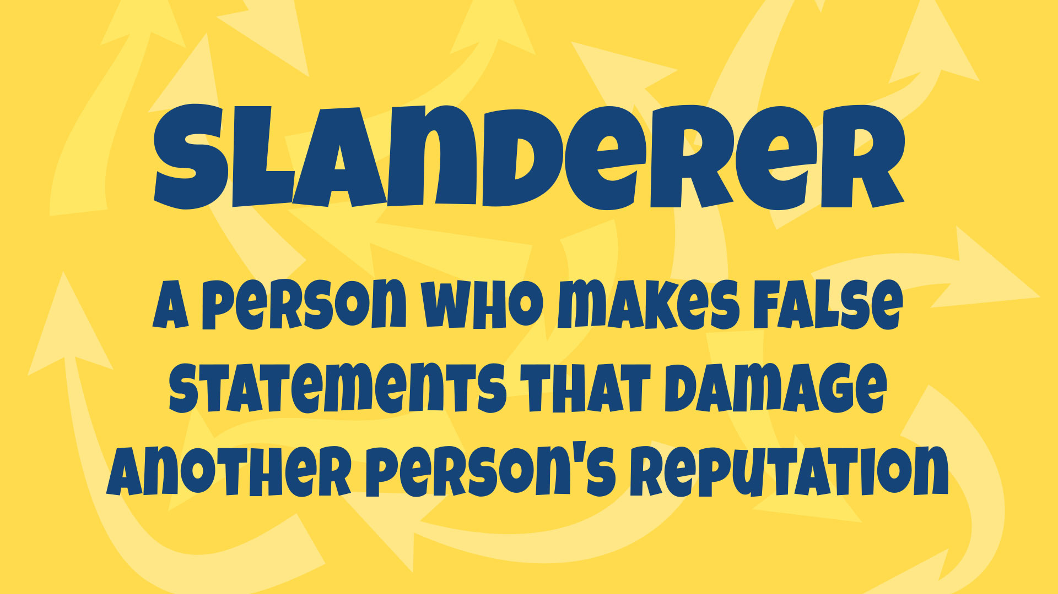

Slide 13
The additional slides below are
provided so the PowerPoint can be adapted to best fit your needs.

Slide 14


Slide 15


Slide 16


